Slide 1

Confidence Intervals, Effect Size and Power
Chapter 8

Slide 2
The Dangers of NHST
We already discussed that statistically significant does not always mean practically important.
Be especially skeptical if they have very large sample sizes (without any of the information presented in this chapter).

Slide 3
Women are bad at Math.
While I joke about being bad at math, I really dislike when people tell me women are not good at math.
Seriously, I was on the state math team.
Cool presentation

Slide 4
Practically Useful Numbers
So what do we do to judge a study for the practical significance?
Confidence Intervals (small = good)
Effect size (big = good)

Slide 5
Confidence Intervals
Point estimate: summary statistic – one number as an estimate of the population
e.g., mean
Just one number rather than an aggregate…

Slide 6
Confidence Intervals
Interval estimate: based on our sample statistic, range of sample statistics we would expect if we repeatedly sampled from the same population
e.g., Confidence interval
Tells you a lot at once!

Slide 7
Confidence Intervals
Interval estimate that includes the mean we would expect for the sample statistic a certain percentage of the time were we to sample from the same population repeatedly
Typically set at 95 or 99%
(hint that matches p<.05, p<.01)

Slide 8
Confidence Intervals
The range around the mean when we add and subtract a margin of error
Confirms findings of hypothesis testing and adds more detail

Slide 9
Confidence Intervals
Maybe a solution to the problems of NHST?
Some argue we should calculate means and CIs and if they do not overlap, that means they are different!
Only works sometimes though …

Slide 10
Confidence Intervals
The calculations are not that different than what we’ve been doing:
Take a z-score where 95% of the data is in the middle of the distribution
Translate that back to a raw score to match the mean.
(draw)

Slide 11
Calculating Confidence Intervals
Step 1: Draw a picture of a distribution that will include confidence intervals
Step 2: Indicate the bounds of the CI on the drawing
Step 3: Determine the z statistics that fall at each line marking the middle 95%
Step 4: Turn the z statistic back into raw means
Step 5: Check that the CIs make sense

Slide 12
Confidence Interval for z-test
M_{lower} = - z(σ_{M}) + M_{sample}
M_{upper} = z(σ_{M}) + M_{sample}
Think about it: Why do we need two calculations?

Slide 13
CI in R
42.5 + qnorm(.05/2, lower.tail = T)*12
42.5 + qnorm(.05/2, lower.tail = F)*12
Made up numbers
Notice the QNORM
Lower tail = T gives you the lower confidence interval
Lower tail = F gives you the upper confidence interval.

Slide 14
Example
Let’s compare the average calories consumed by patrons of Starbucks that posted calories on their menus to the population mean number of calories consumed by patrons of Starbucks that do not post calories on their menus (Bollinger, Leslie, & Sorensen, 2010).
The population mean was 247 calories, and we considered 201 to be the population standard deviation. The 1000 people in the sample consumed a mean of 232 calories.

Slide 15
Think About It
Which do you think more accurately represents the data: point estimate or interval estimate?
Why?
What are the advantages and disadvantages of each method?

Slide 16
Effect Size: Just How Big Is the Difference?
Significant = Big?
Significant = Different?
Increasing sample size will make us more likely to find a statistically significant effect

Slide 17
Effect Size: Just How Big Is the Difference?
 | Small Effect Size | Big Effect Size
Fail to reject null | Probably not there, sample size not issue | Important! May not have enough people in study
Reject null | Probably not there, sample size may be causing rejection (Type 1) | Important and we found it! (power).

Slide 18
What is effect size?
Size of a difference that is unaffected by sample size
How much two populations do not overlap
Standardization across studies

Slide 19
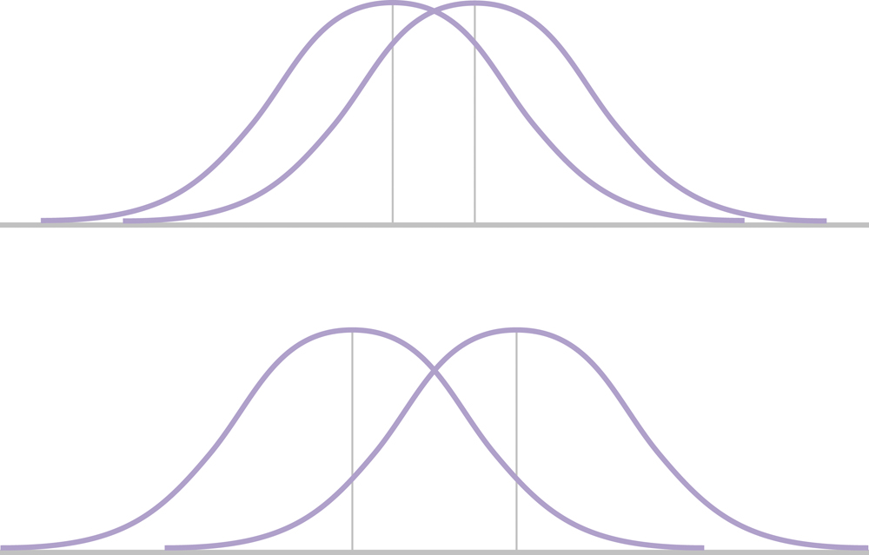
Effect Size & Mean Differences
Imagine both represent significant effects: Which effect is bigger?

Slide 20
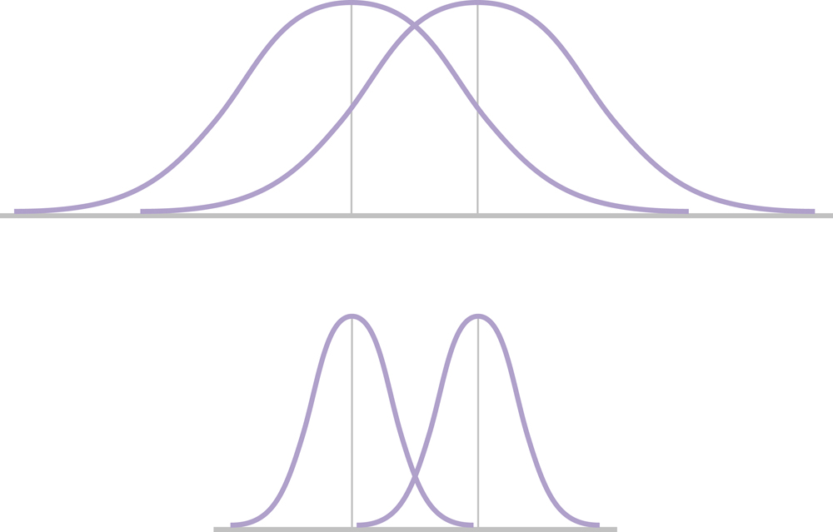
Effect Size and Standard Deviation
Note the spread in the two figures: Which effect size is bigger?

Slide 21
Increasing Effect Size
Decrease the amount of overlap between two distributions:
1. Their means are farther apart
2. The variation within each population is smaller

Slide 22
Calculating Effect Size
Cohen’s d Estimates effect size
Assesses difference between means using standard deviation instead of standard error

Slide 23
Example
Let’s compare the average calories consumed by patrons of Starbucks that posted calories on their menus to the population mean number of calories consumed by patrons of Starbucks that do not post calories on their menus (Bollinger, Leslie, & Sorensen, 2010).
The population mean was 247 calories, and we considered 201 to be the population standard deviation. The 1000 people in the sample consumed a mean of 232 calories.

Slide 24
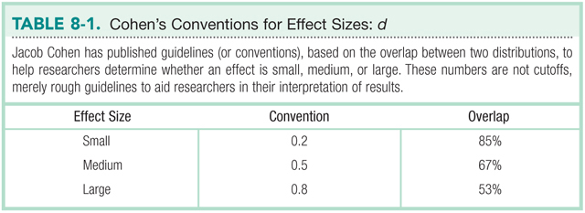

Slide 25
Statistical Power
The measure of our ability to reject the null hypothesis, given that the null is false
The probability that we will reject the null when we should
The probability that we will avoid a Type II error

Slide 26
Power Rangers Example
See handout!

Slide 27
Calculating Power
Step 1: Determine the information needed to calculate power
Population mean (um)
Standard error (N, o needed)
Sample mean found (M)

Slide 28
Calculating Power
Step 2: Determine a critical z value (cut off score)
Calculate raw score for that z:
Mneeded = um + (om)*z

Slide 29
Calculating Power
Step 3: Figure out the distance between the M needed and sample M you estimated
Z = (Mneeded – Msample) / om
Then the percentage of the distribution above/below that score is power
(matches your hypothesis of higher or lower)

Slide 30
What increases power?

Slide 31
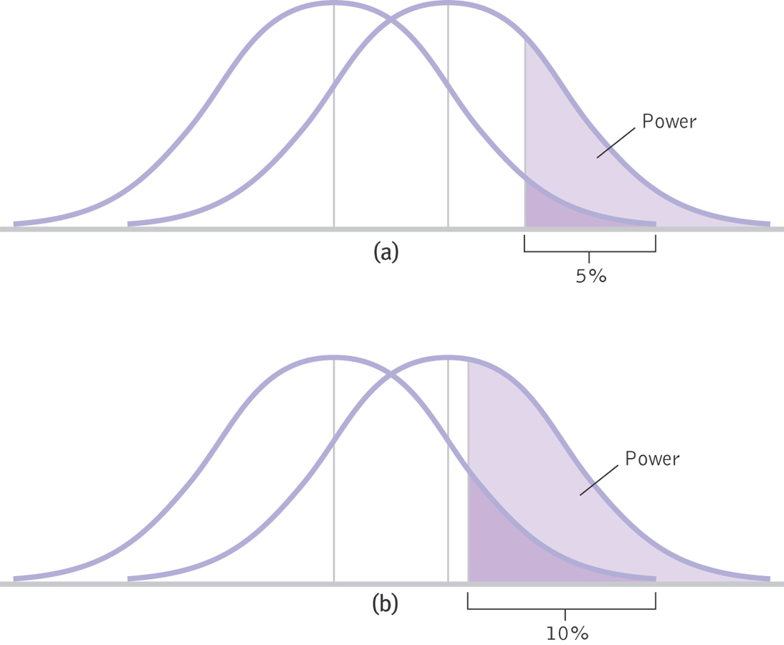
Increasing Alpha

Slide 32
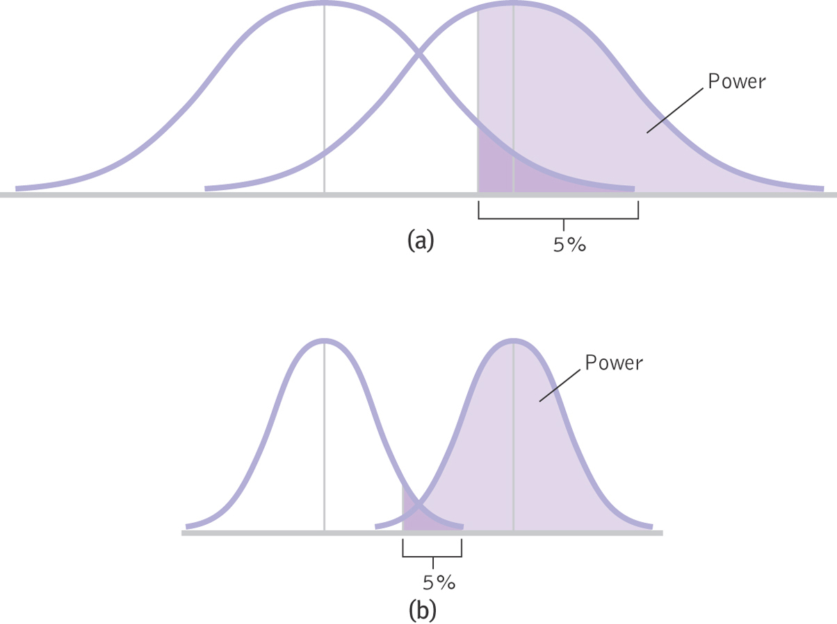
Two-Tailed Verses One-Tailed Tests

Slide 33
Increasing Sample Size or Decreasing Standard Deviation
Both of these decrease standard error

Slide 34
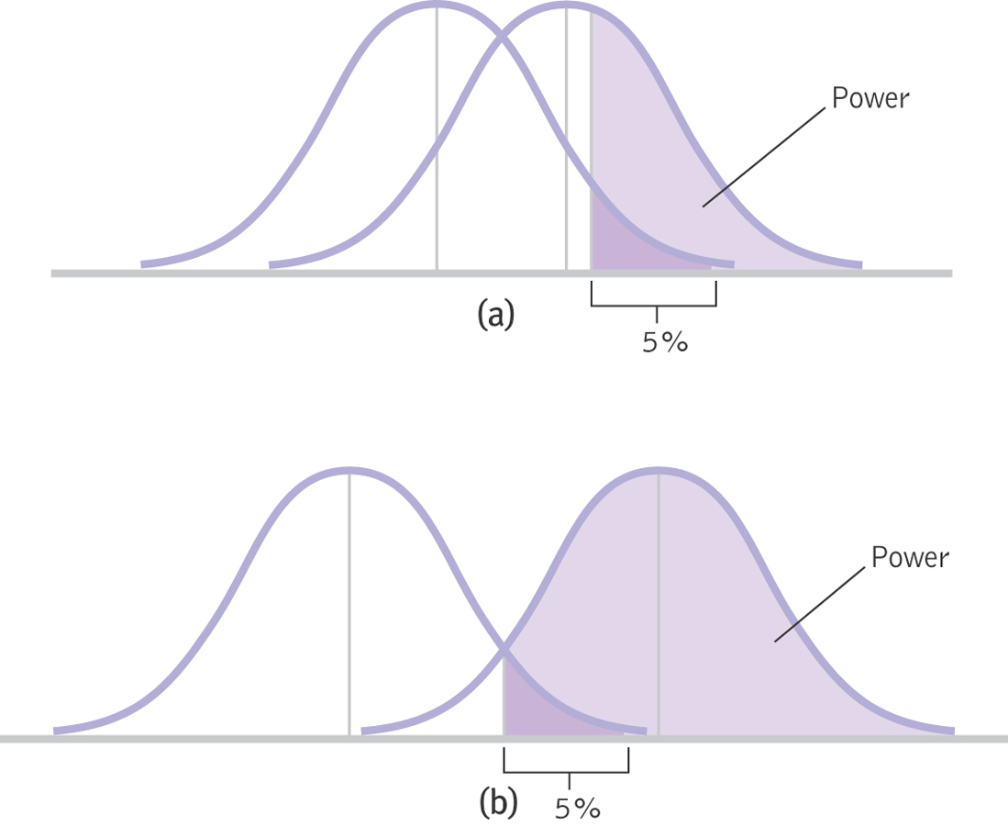
Increasing the Difference between the Means
Effect size

Slide 35
Factors Affecting Power
Larger sample size increases power
Alpha level
Higher level increases power (e.g., from .05 to .10)
One-tailed tests have more power than two-tailed tests
Decrease standard deviation
Increase difference between the means

Slide 36
Think About It
Why would it be important to know the statistical power of your study?

Slide 37
Meta-Analysis
Meta-analysis considers many studies simultaneously.
Allows us to think of each individual study as just one data point in a larger study.

Slide 38
The Logic of Meta-Analysis
STEP 1: Select the topic of interest
STEP 2: Locate every study that has
been conducted and meets the criteria
STEP 3: Calculate an effect size, often Cohen’s d, for every study
STEP 4: Calculate statistics and create appropriate graphs

Slide 39
